Slide 1
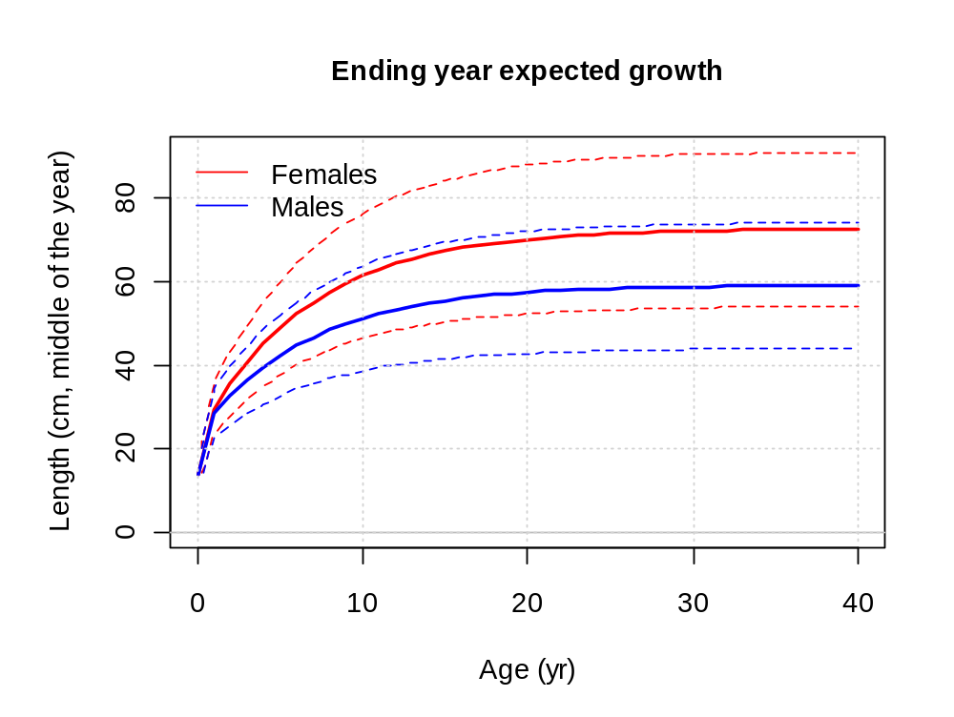
Modeling growth in Stock Synthesis

Slide 2
Growth curves
The von Bertalanffy, parameterized in terms of,
  length at a given young age,
  length at a given old age (or optionally L∞)
  growth rate parameter, K
Growth increment is modeled as a function of current length, current year’s L∞ and K
  allow for temporal changes in growth without individuals shrinking

Slide 3
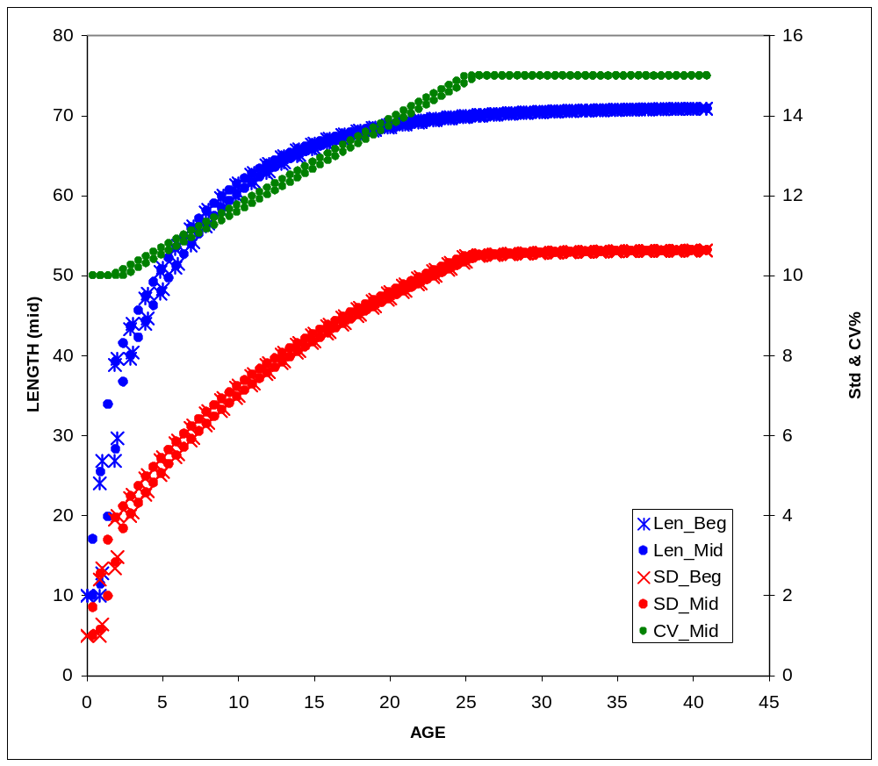
Growth example
Example showing:
  Two birth seasons
  CV = F(A)
  Season durations:
  10 months
  & 2 months

Slide 4
Additional growth options
Cohort-specific growth
  Create as time-varying adjustment to the CGD parameter which has a base value of 1.0
  Acts as multiplier on K
  allows variation in growth rates between cohorts
  may be due to intra-cohort density dependence (not modeled explicitly), genetics, or other factors
Schnute’s generalized growth curve (a.k.a. Richards curve)
  has additional parameter that generalizes the von Bertalanffy curve
Age-specific K

Slide 5
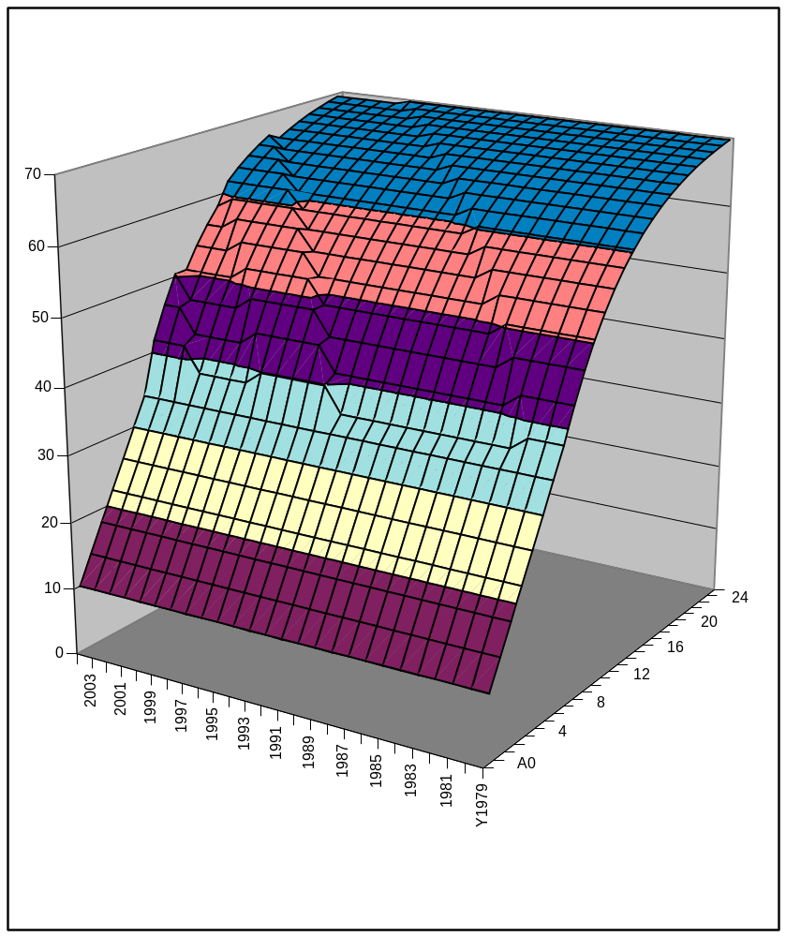
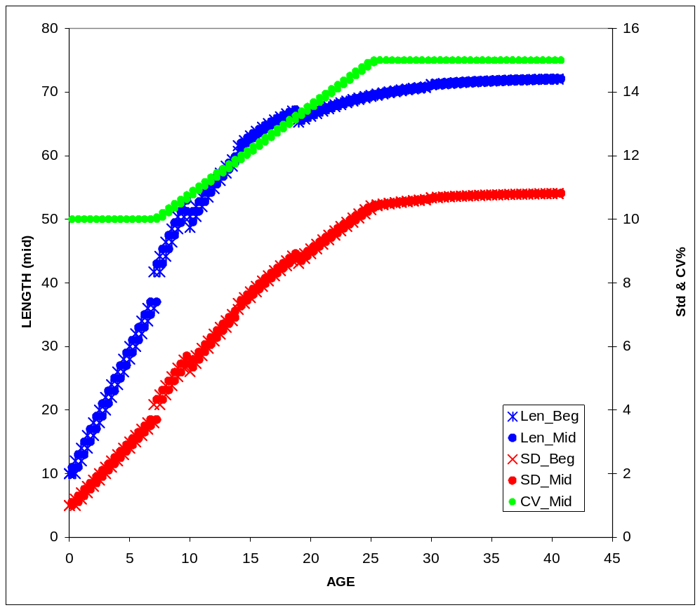
Cohort Growth Deviation

Slide 6
Age-Specific K
Parameter value is a simple multiplier on the K for the previous age; so creates a random walk
………….
3 # GrowthModel: 1=vonBert with L1&L2; 2=Richards with L1&L2; 3=age_speciific_K; 4=not implemented
1 #_Growth_Age_for_L1
999 #_Growth_Age_for_L2 (999 to use as Linf)
5 # number of K multipliers to read
3 5 7 9 11
………
#_growth_parms
#_LO HI INIT PRIOR PR_type SD PHASE
0.05 0.15 0.1 0.1 -1 0.8 -1 0 0 0 0 0 0 0 # NatM_p_1_Fem_GP_1
10 45 30 30 -1 10 1 0 0 0 0 0 0 0 # L_at_Amin_Fem_GP_1
40 250 200 200 -1 10 1 0 0 0 0 0 0 0 # L_at_Amax_Fem_GP_1
0.001 0.5 0.1 0.1 -1 0.8 -2 0 0 0 0 0 0 0 # VonBert_K_Fem_GP_1
0.01 3 1 1 -1 0.8 3 0 0 0 0 0 0 0 # Age_K_Fem_GP_1_a_3
0.01 3 1 1 -1 0.8 3 0 0 0 0 0 0 0 # Age_K_Fem_GP_1_a_5
0.01 3 1 1 -1 0.8 3 0 0 0 0 0 0 0 # Age_K_Fem_GP_1_a_7
0.01 3 1 1 -1 0.8 3 0 0 0 0 0 0 0 # Age_K_Fem_GP_1_a_9
0.01 3 1 1 -1 0.8 3 0 0 0 0 0 0 0 # Age_K_Fem_GP_1_a_11

Slide 7
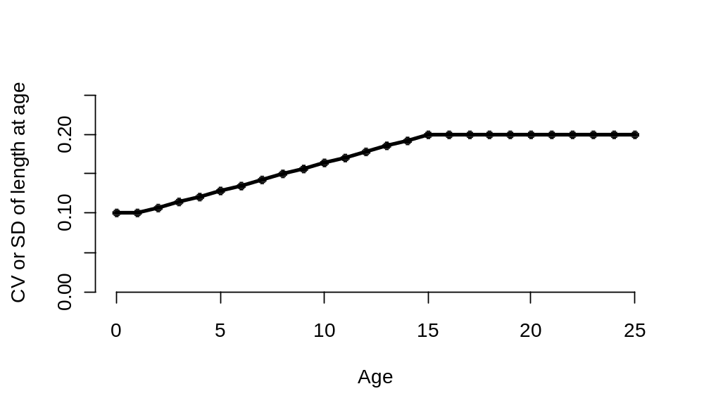
Variation of length at age
Several linear functions are available to model the variation of length at age
  CV as a function of length at age
  CV as a function of age
  SD as a function of length at age
  SD as a function of age
Dogleg pattern uses growth A_{min} and A_{max}

Slide 8
Growth patterns
Can be used to model the difference in growth among sub-populations
In a multi-area model, the distribution of recruitment among areas and growth patterns is controlled by estimable parameters
When an individual changes areas, it maintains the growth parameters of its specified growth pattern

Slide 9
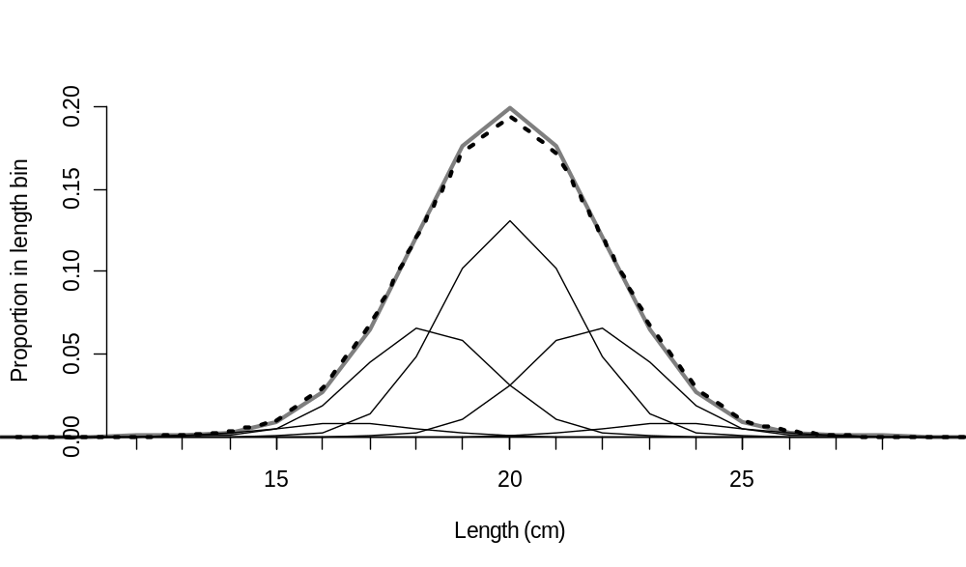
Growth platoons for size-survivorship
3 or 5 platoons (morphs) nested within growth patterns and genders
Used to account for the effect of size specific selectivity in the population size structure at age by dividing cohort into components with different size-at-age
Size selectivity then causes different F-at-age for the different morphs

Slide 10
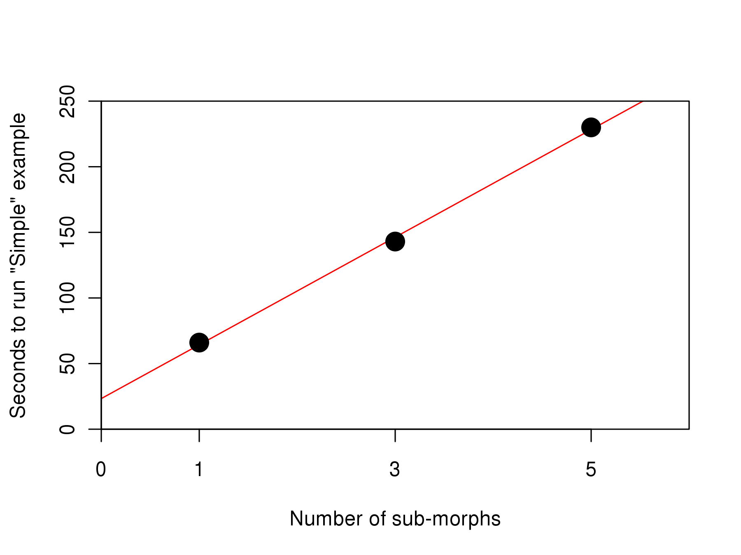
No free lunch

Slide 11
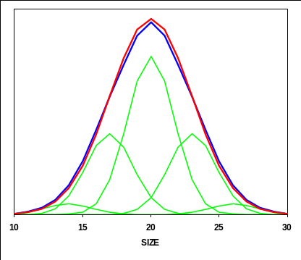
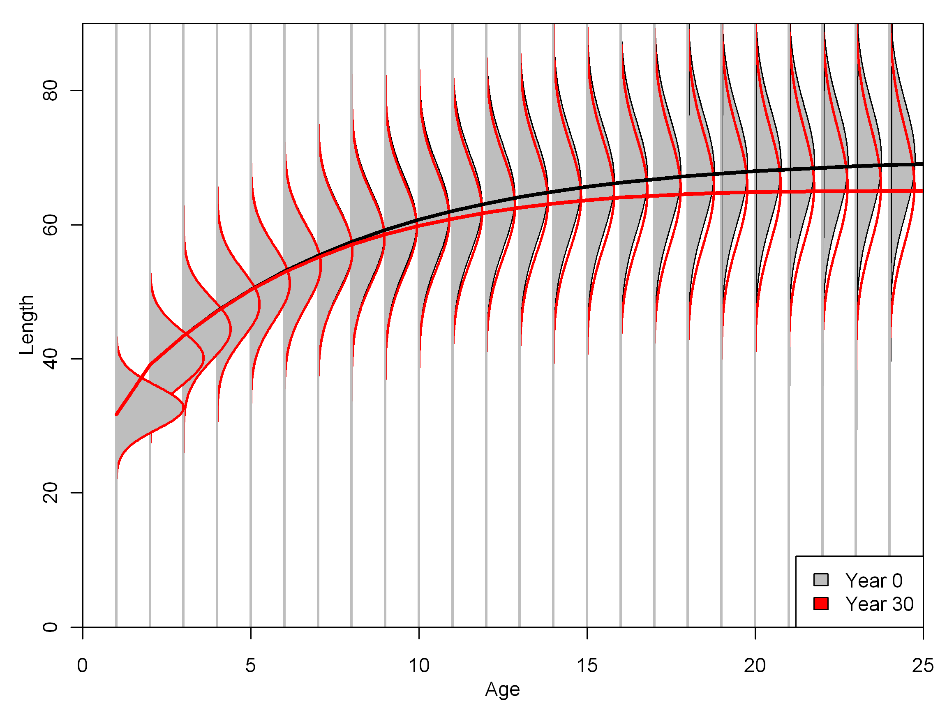
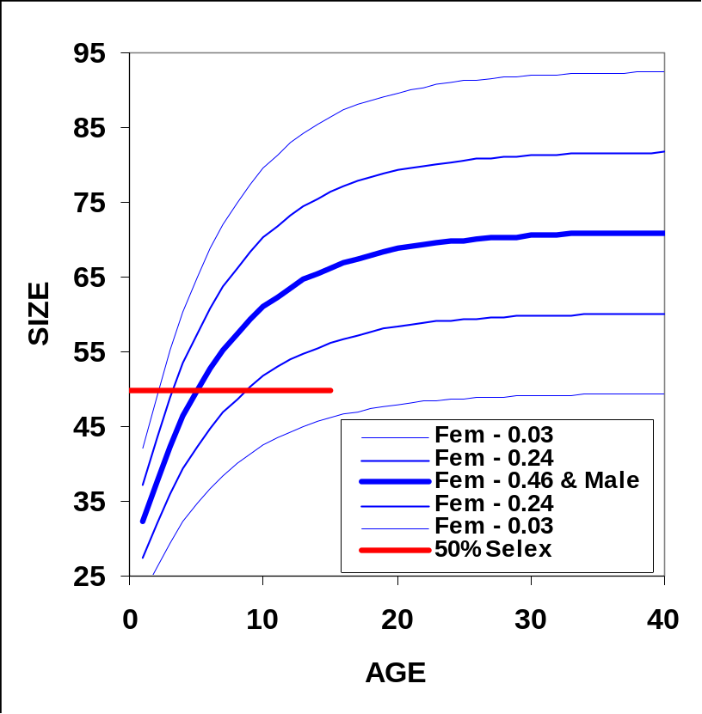
Length-Specific Survivorship
Notes:
Finally, let’s return to the growth morph issue
I didn’t tell you this before, but this test model was a two-gender model. The male gender uses one morph with this middle growth curve and a high variance about that curve. The females were built up from 5 morphs with narrower variability in each. Together, the 5 female morphs look just like the male morph, but only in the absence of fishing.
Given the size selex, the upper 3 female morphs have much more exposure to the fishery than do the lower 2 morphs
Because males have just one morph, their mean size does not change over time and stays same as female 1971
Female mean size declines substantially. The bend you see is an indication that the mean size of the old fish is not yet in balance with the size-survivorship
This multiple-morph approach takes no more estimated parameters. It just takes the assertion that a growth structure based upon multiple morphs is more accurate than a single morph.

Slide 12
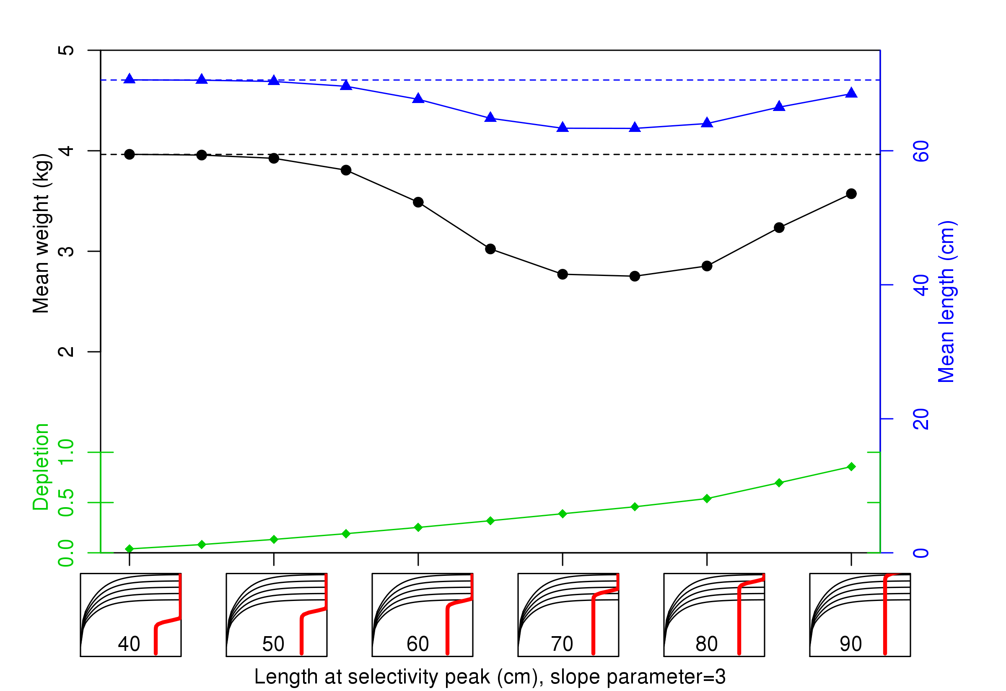
Growth morph example
Interaction between selectivity and
mean weight and length (at age 30)

Slide 13
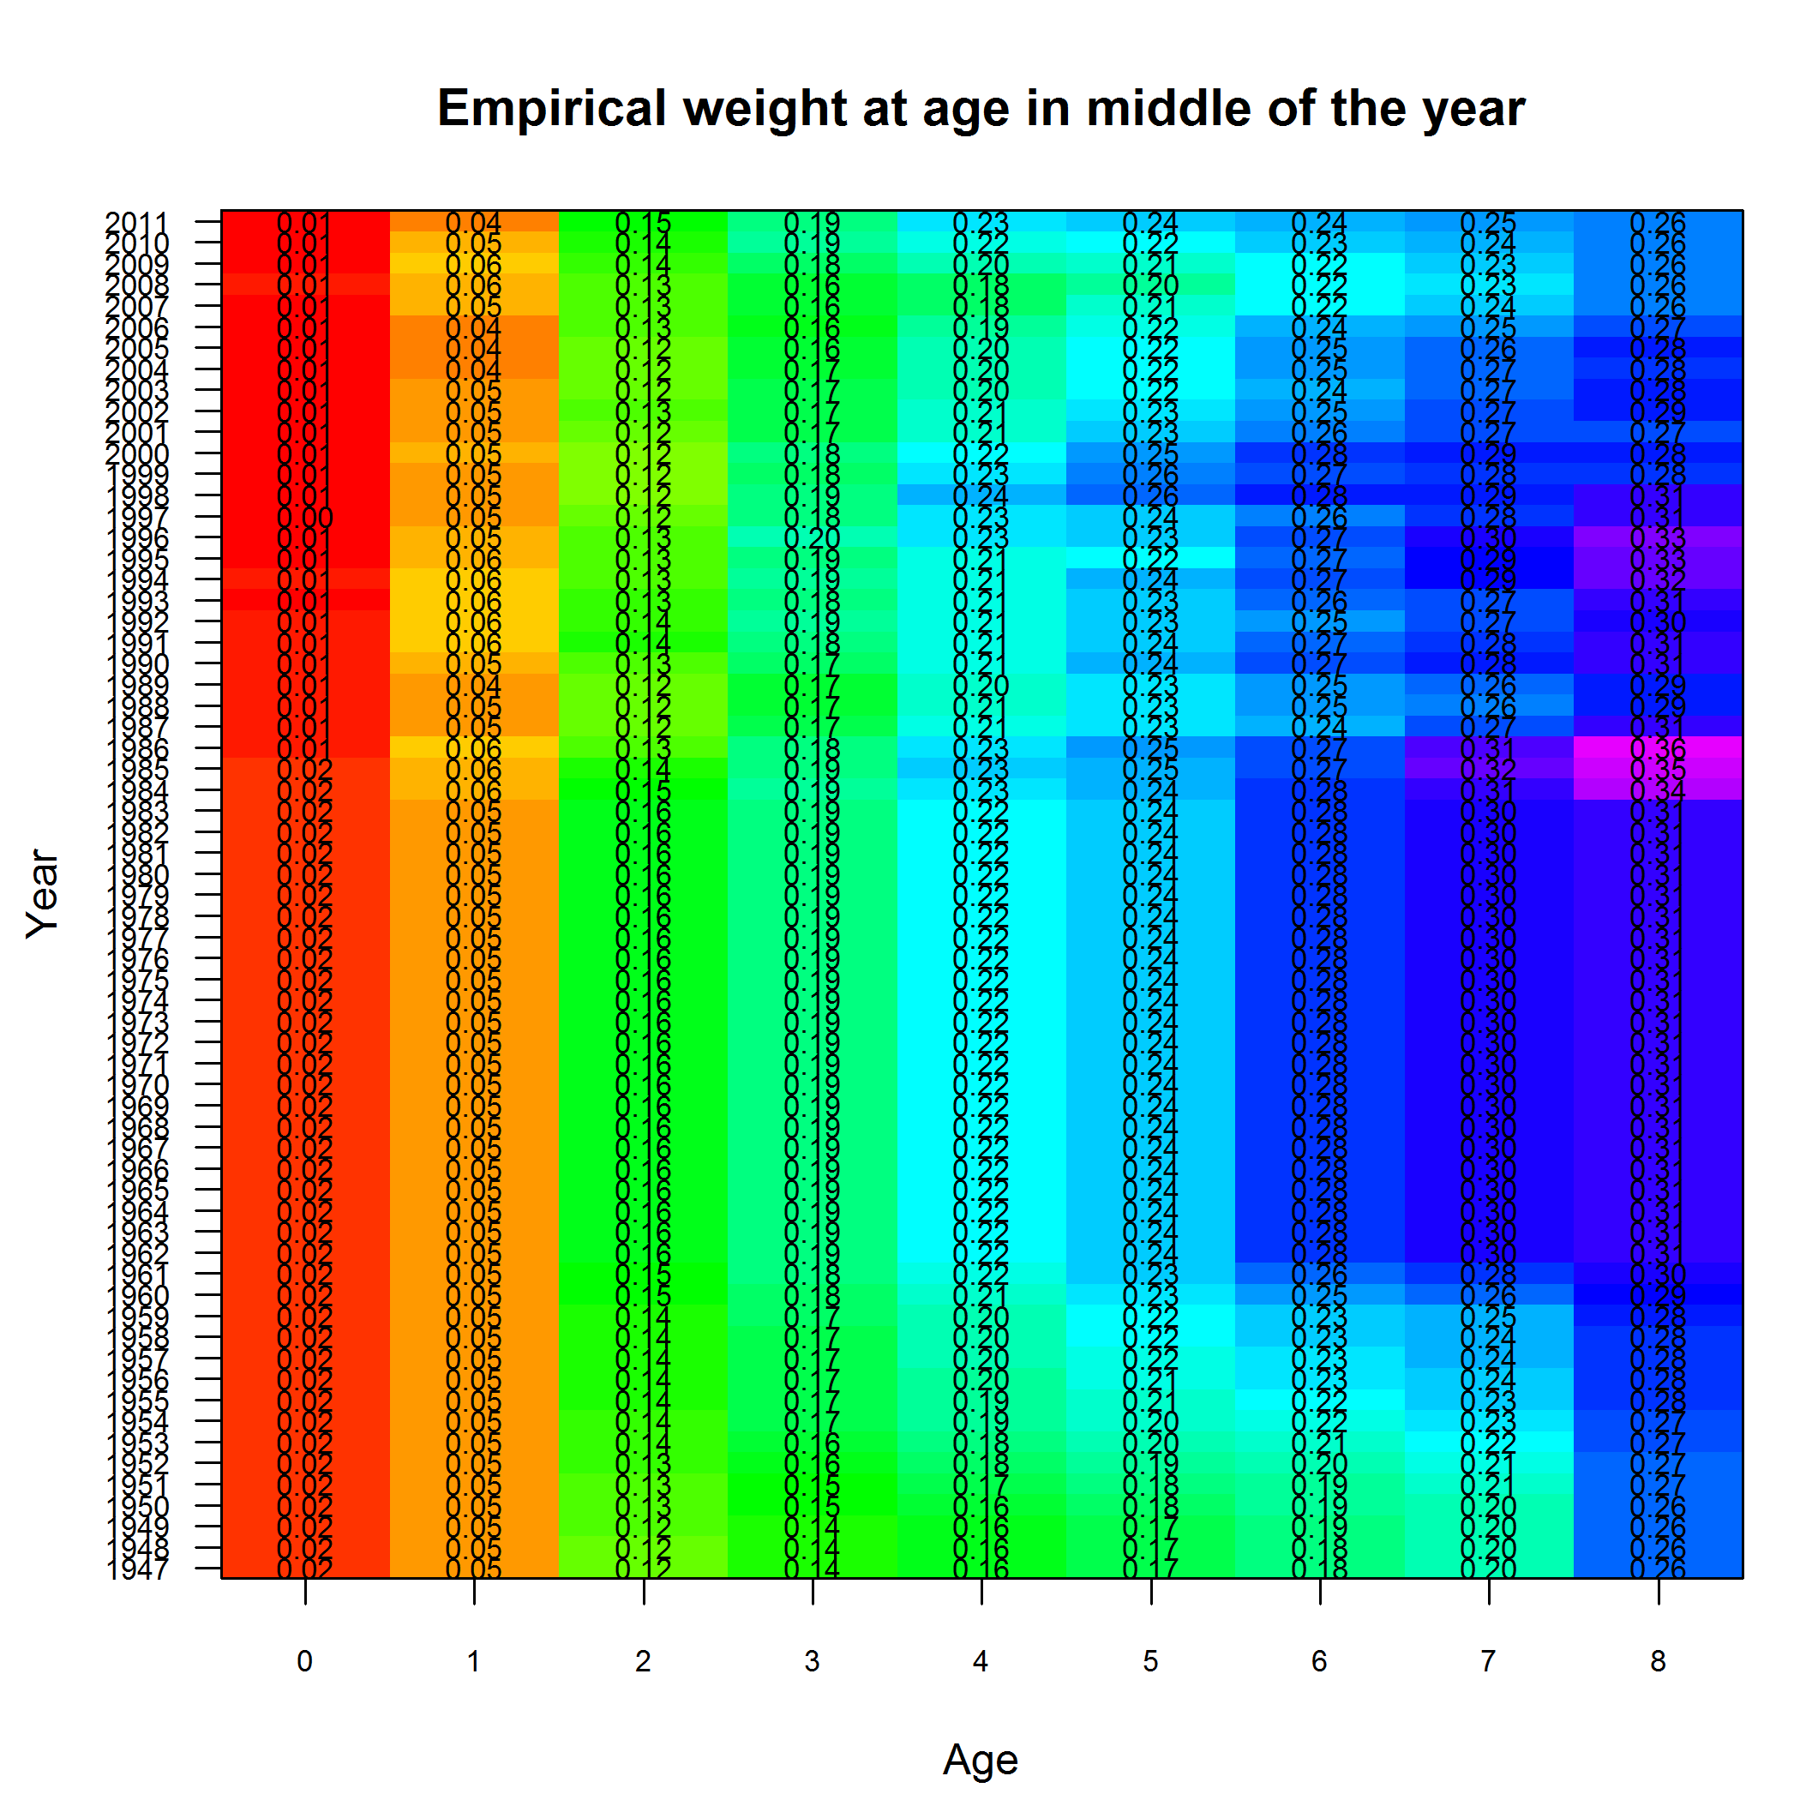
Empirical weight at age (NS Herring)

Slide 14
Data Needs
Distinct length modes in length comp data
Mean length (or body wt)-at-age data
Conditional age-at-length data

Slide 15
Growth Estimation Notes
If there is an existing set of growth parameters, consider using as priors and let SS update
Be alert for existing growth curve to be half year shifted along age axis compared to SS’ time stanzas
CAAL data is voluminous and will slow the model

